Slide 1

CELL THEORY
DR.SONAL MISHRA
)

Slide 2



1) Introduction
2 ) Cell theory
Exceptions of cell theory
The cell
Reference

Slide 3




*The term cell was given by Robert hook ( 1965) While his binding on thin stick of cark cellar = small rooms on compartment.
Detailed morphological and physiological studies of cell was first made by schwann (1839) he is regarded as father of cell biology.
The study of cell is called cell biology or cytology in Greek kyats- hallow space or vessel &loges-study.

Slide 4
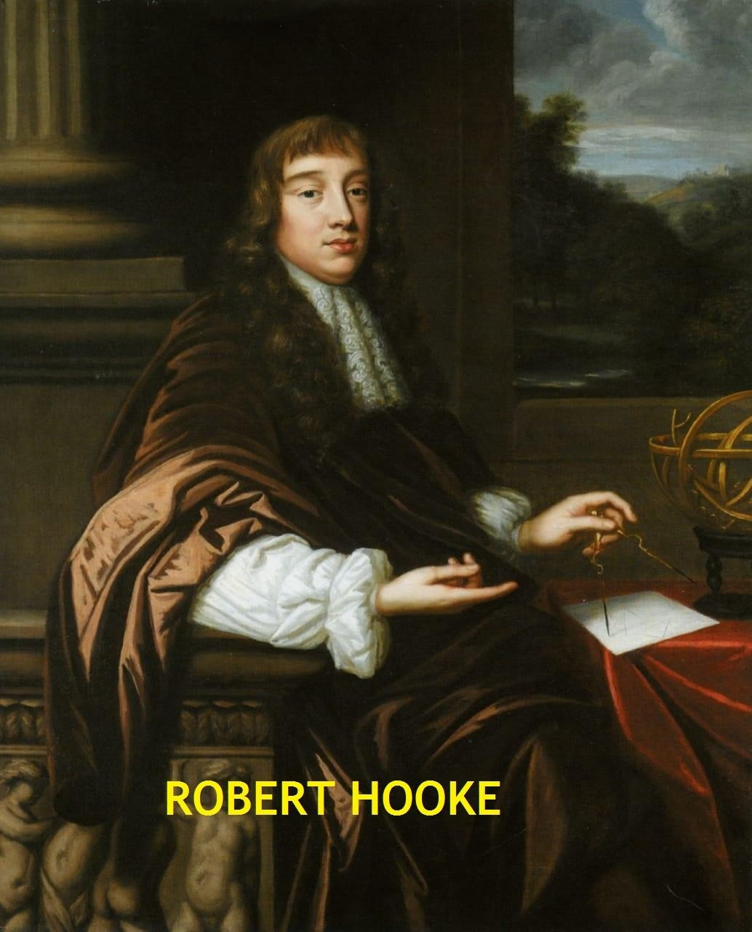
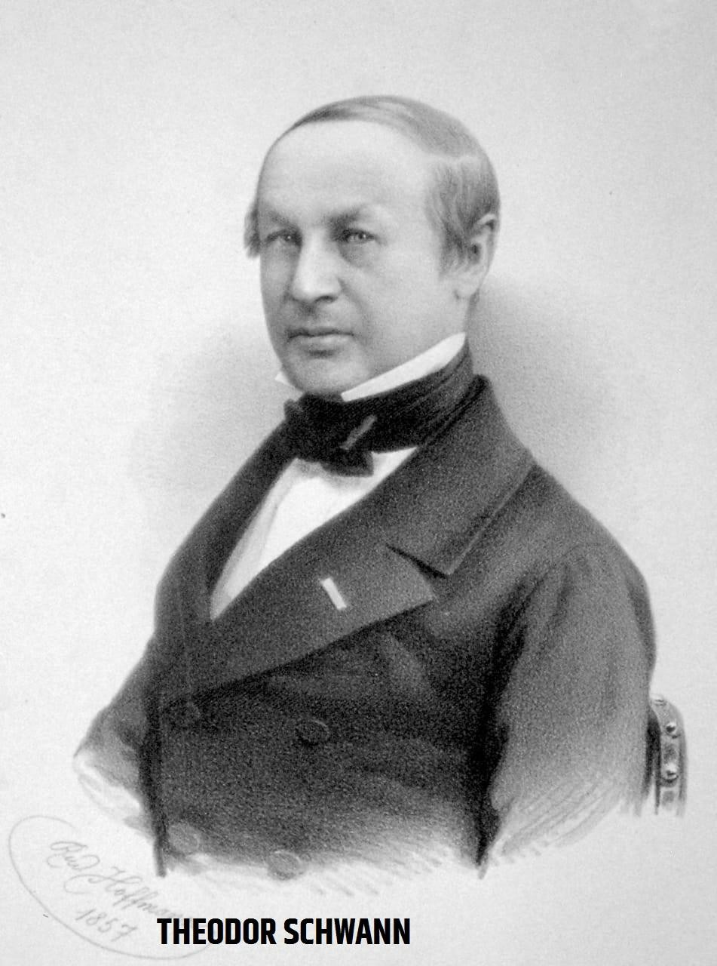

Slide 5
The cell theory proposed by two Germen scintist Mathios jakeb scheiden (1838) on plant cell and Theodore Schwann (1839) on animal cell . This theory has two main point---
Cell are the structural unit of living beings.
Cell can act independently and also function as an integral part of complete organism.
Example= The activities of an organism are the outcome of the coordinated action of its consistent cells.

Slide 6
Better instrumental and study techniques in 20th century have reveled many details about the cell structure and function . Based on there finding modern cell theory have been proposed called cellprincipal .
Imported feature of cell principal are as following
Cells are structural and functional unit of living organism ie.- they made up of cells.
Cells always originate from pre existing cells.
Cell for their survival maintain homoeostasis .

Slide 7
Cells are responsible for all the metabolic activities with in the living organism so are physiological unit of living being .
Cell contain hereditary material and are responsible for all the transmission of character .
A cell is a small mass of protoplasm containing a nucleus along with some organelles and is bounded by plasma membrane
.
cell organelles are not capable of their survival alone .
Genetic information stored and expressed within cells .

Slide 8
Many organism are unicellular and multinucleated .
Example- protozoons , some fungai , phythium , phytopthora , some alae such as vaucheria etc.
Viruses are acellular in nature made up of nucleic acid and protein and lacks protoplasm they are living inside host cell and behave completely as non living outside a host cell .
Bacteria and blue green algae lack well devolepd nucleus.

Slide 9

‘’In the body of every plant and animal, protoplasm is found it the form of a living things i.e. –chemically reactive object , ‘’
‘’ The cell is vital unit surrounded by plasma membrane and has the capacity of self reproduction. ‘’
LOEWLY AND SIEKEVITZ
‘’ The cell is fundamental and smallest unit of living organism having the capacity of its complete existence limited externally by a differentially permeable membrane which has the capacity of self
reproduction ‘’

Slide 10
